Slide 1
Microscopic Image Dataset of Plant- Parasitic Nematodes
CSE 475
Sec:02
Group:04
Parvaze Mahmud Bitto 2022-1-60-133
Sadia Afrin Anamika 2022-1-60-100
Hridoy Ahmmad Akash 2022-1-60-299
Sayma Sultana 2022-1-60-405
Md. Momtajur Rahman 2022-1-60-370
Dr. Raihan Ul Islam
Associate Professor
Dept. of Computer Science & Engineering
East West University

Slide 2
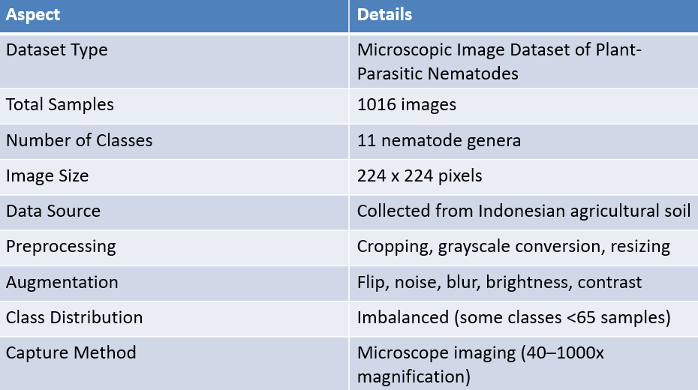
Dataset Summary

Slide 3
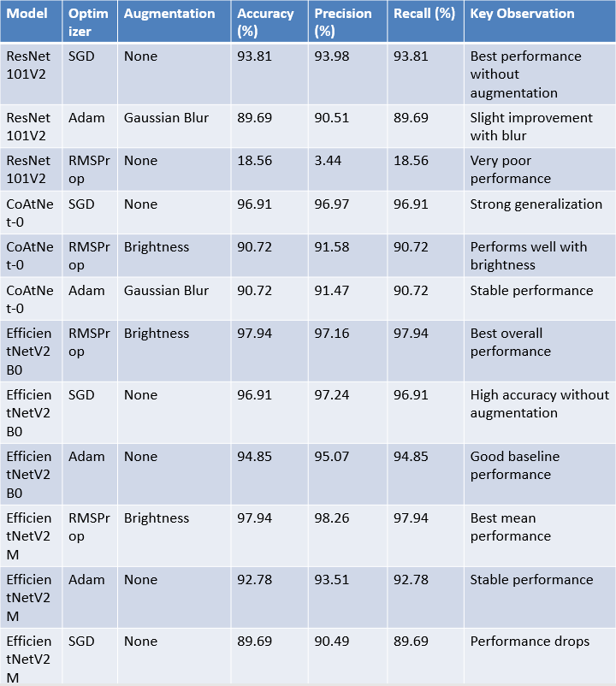
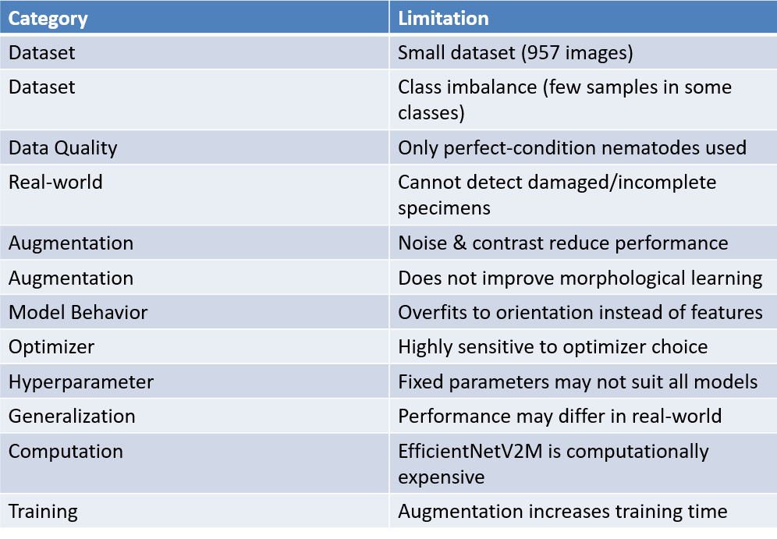
Related Work

Slide 4
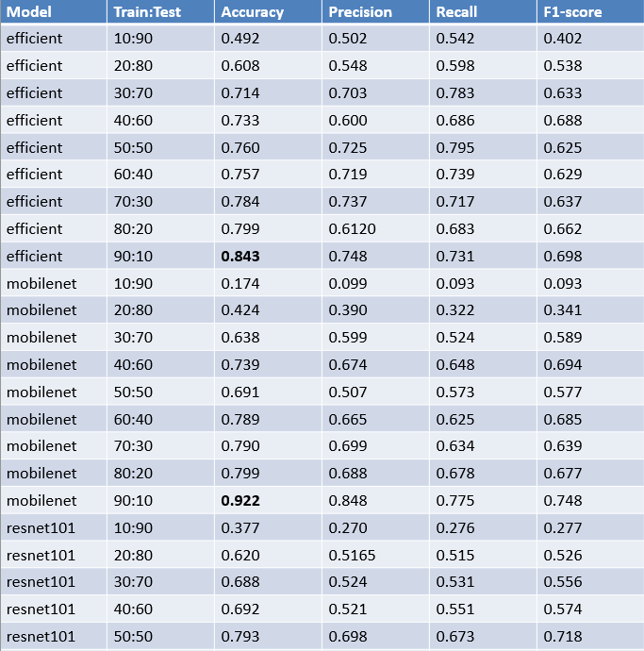
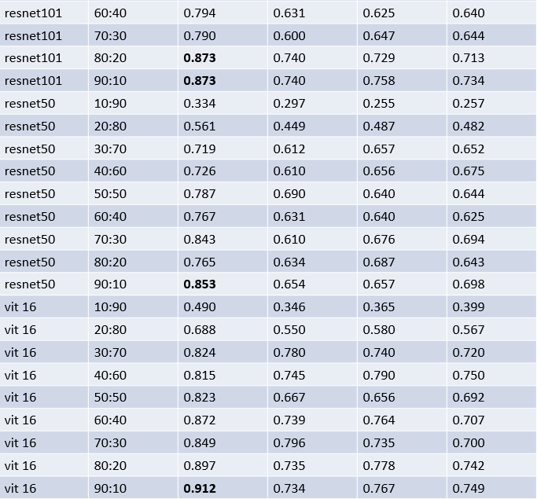
Supervised Methods

Slide 5
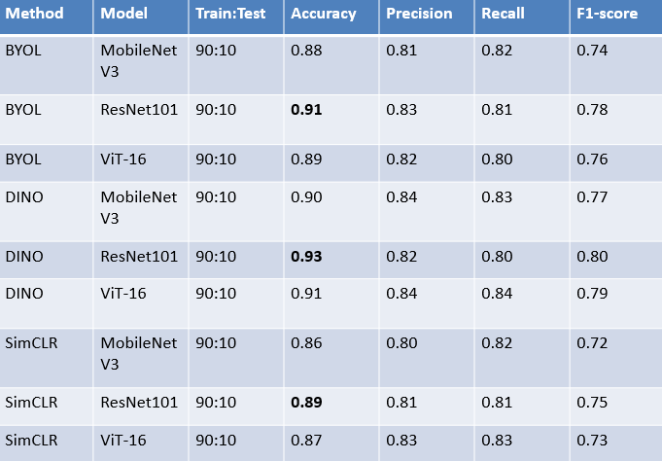
SSL Methods

Slide 6
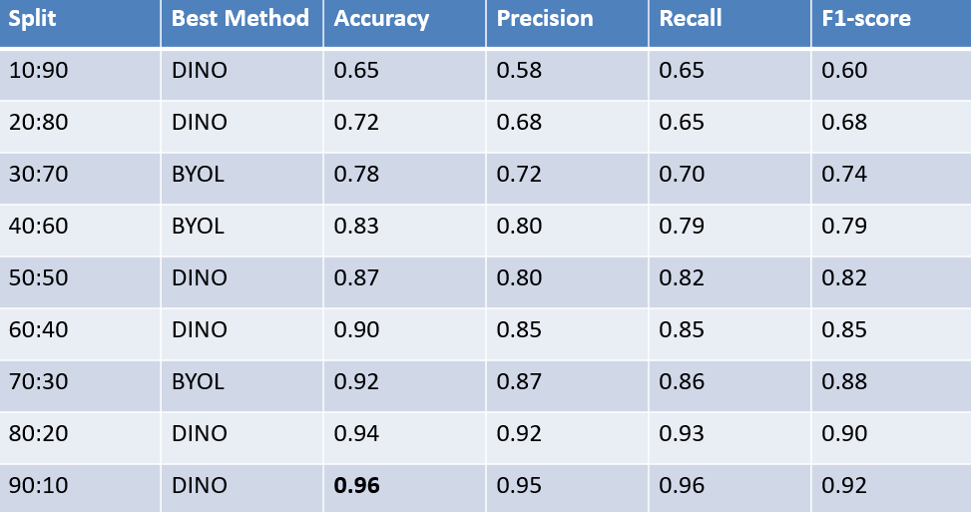
Best SSL Method Train:Test

Slide 7
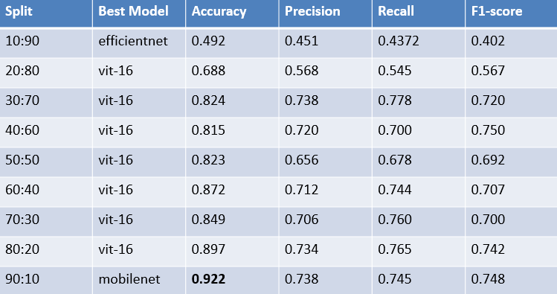
Best Supervised Train:Test

Slide 8
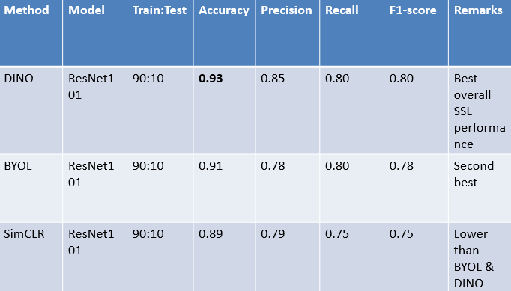
Best SSL Method

Slide 9
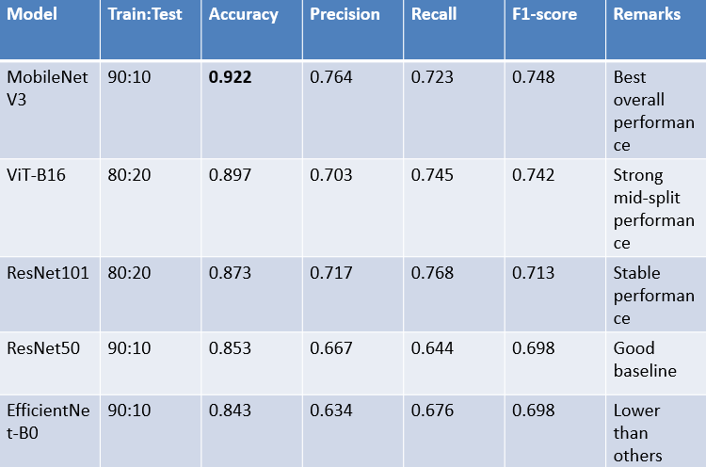
Best Supervised

Slide 10
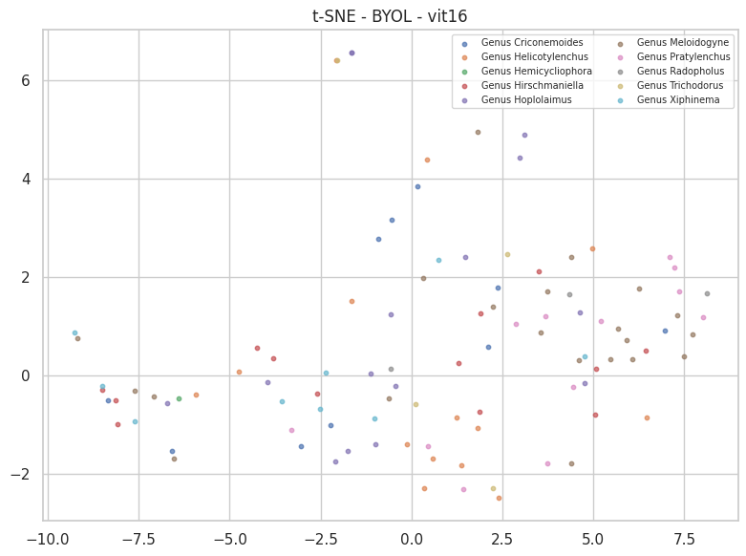
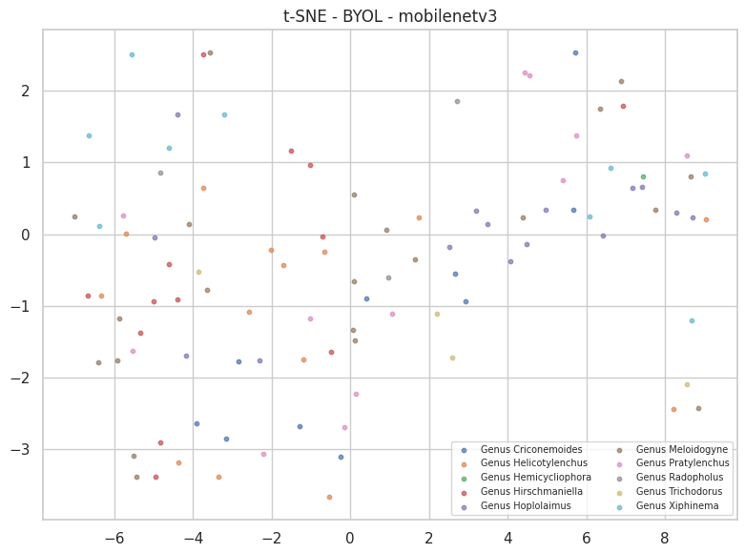
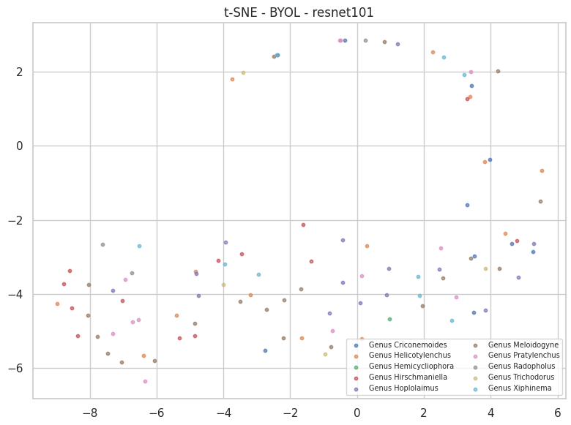
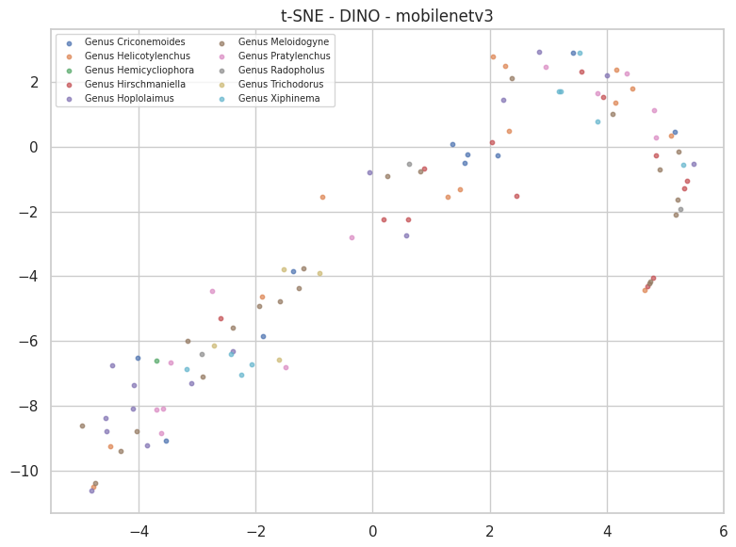
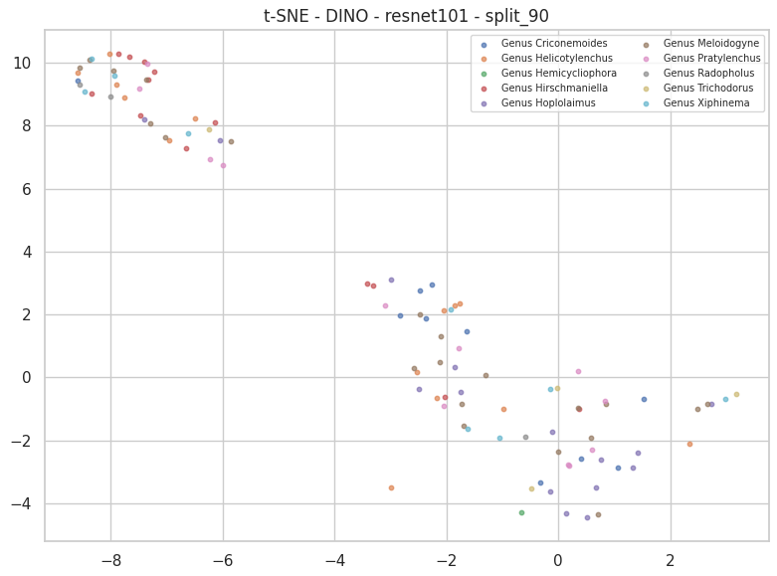
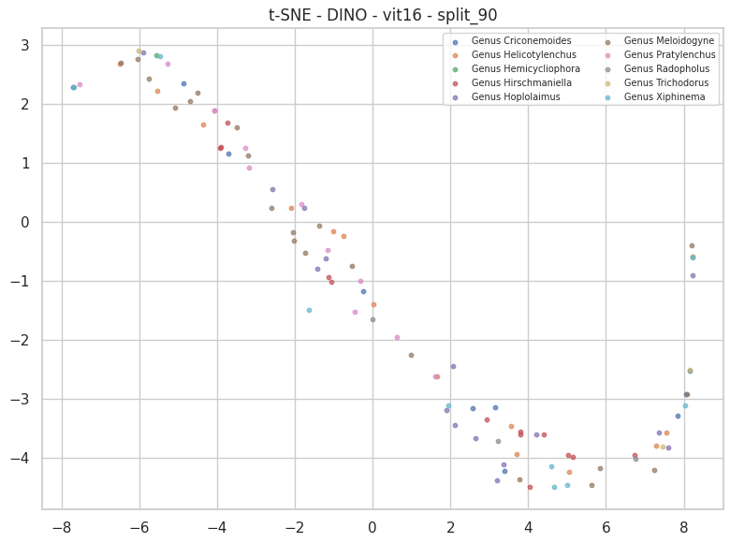
t-SNE Graph

Slide 11
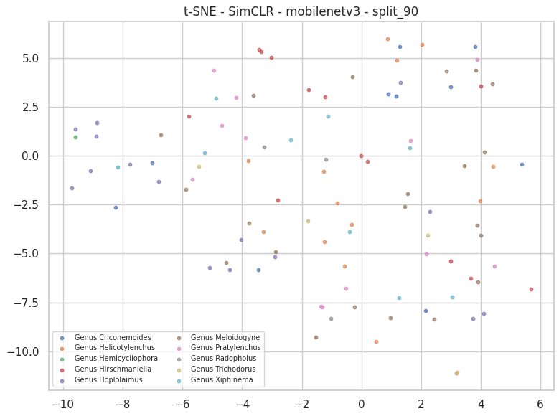
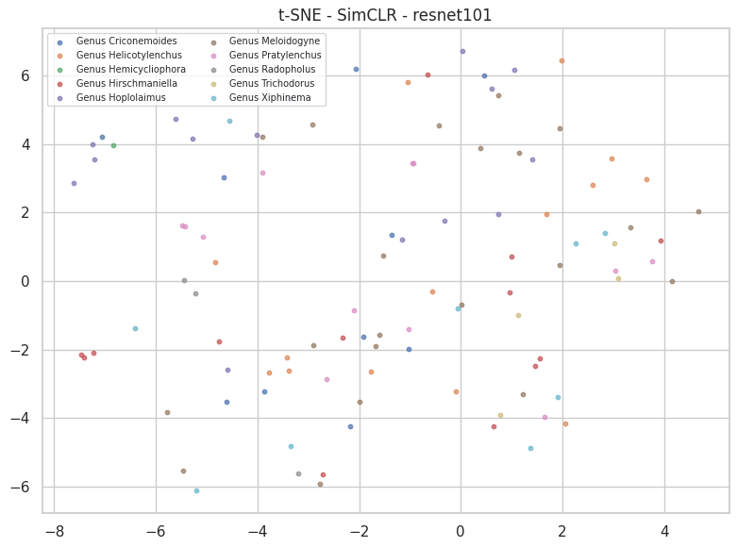
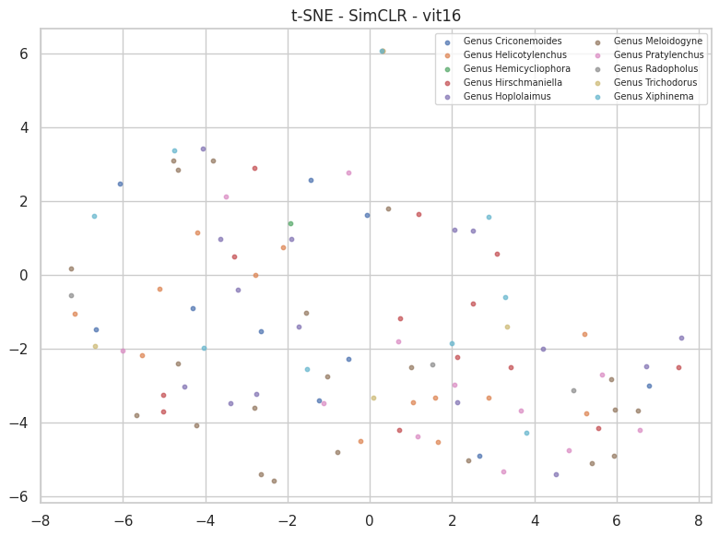
t-SNE Graph

Slide 12
Supervised learning models achieved higher accuracy compared to SSL methods.
. Performance improves significantly with higher training data (e.g., 90:10 split).
Among supervised models, MobileNet/ViT-16 showed the best overall results.
Among SSL methods, DINO provided the most stable performance.
SSL methods are effective when labeled data is limited.
This study demonstrates the effectiveness of deep learning for microscopic nematode classification.
Conclusion

Slide 13


